Slide 1

Exploratory Data Analysis Group 3
JASPREET KAUR
AKSHAY JADHAV
ADITI JAIN
25-March-2020
AISHWARYA KATE
RASHMI JAIN
SHIVANI JAIN

Slide 2
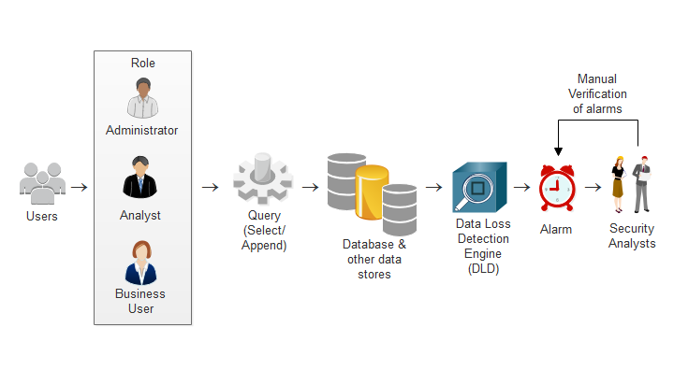
Project analysis slide 2
JASPREET KAUR
Problem Statement
Let’s make the process more efficient!
Figure 1.1 Diagram depicting the problem of CISO
Notes:
CISO (Chief Information Security Office) identifies that thousands of alarms are generated when a database/data store is accessed by any user – out of which maximum are false alarms. So, what really happens here is that whenever any user tries to access a database (say, by writing some query), the Data Loss Detection Engine (security application) understands that somebody has accessed the database and generates an alarm. Now, a report is generated of the total True and False alarms, and is sent to the Security Analysts. Now, the security analysts perform a manual verification of all the alarms – but many alarms are ignored by them during this inspection mainly due to huge volume of the alarms and time constraints. This is a real issue that most organizations face today and suffer as a result of not identifying a real alarm among the many false positive alarms.

Slide 3
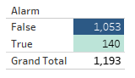
Project analysis slide 2
JASPREET KAUR
Problem Statement
UNAUTHORIZED DISCLOSURE OF CONFIDENTIAL INFORMATION
LOST COMPETITIVE ADVANTAGE
THE PROBLEM OF FALSE ALARMS
DATA LOSS
FINANCIAL RISKS
ALARMS IGNORED DUE TO TIME & VOLUME CONSTRAINTS
LOW GOODWILL OF THE ORGANIZATION
Notes:
As said earlier, this is a real issue which can have negative impacts like unauthorized disclosure of confidential information, data loss, of course, true alarms are ignored, the competitive advantage is lost because of which there can be huge financial loss and thus, the reputation of the organization can be completely damaged.

Slide 4
Project analysis slide 3
JASPREET KAUR
Exploratory Data Analysis Goal
SET OF INDEPENDENT VARIABLES
INTER-RELATIONSHIPS AMONG THE ATTRIBUTES (VARIABLES)
INTERESTING SUBSETS OF THE OBSERVATIONS
OVERVIEW OF THE NUMBER OF FALSE POSITIVE AND TRUE POSITIVE ALARMS
POSSIBLE MACHINE LEARNING MODELS BASIS THE RESULTS
Notes:
Now, our goal is to be able to do an Exploratory Data Analysis so we could really identify and provide a set of independent variables for analysis, establish inter-relationships and/or correlation among the attributes or variables, find out interesting observations, also provide with the overview of the number of false and true alarms generated after a particular user accesses a database and finally recommend few machine learning models (actually 3) based on the Exploratory Data Analysis.

Slide 5
Project analysis slide 4
JASPREET KAUR
Independent Variables Chosen for Analysis
Timestamp
Shivani
Requestor
Aishwarya
Role
Aditi
(the date & time when the alarm was generated)
(the User ID or job name that tried to access the database)
(the role filed in the system)
Component Accessed
Request Type
Violation Type
Jaspreet
Akshay
Rashmi
(Database component being accessed: Element, Table, Node, Cluster)
(Database commands: Select, Append)
(description of the violation of the access)
Notes:
Each of the variables have been chosen as follows: Timestamp – that indicates the date and time when the alarm was generated, is taken by Shivani. Aishwarya, has chosen Requestor (which is the user id or the job name that tried to access the database. Aditi has chosen Role (it is the role that is filed in the system). I have chosen Component (which describes the database component being accessed: Element, Table, etc.). Request Type (is the database command) – and has been chosen by Akshay. Lastly Violation Type (which is the description of the violation of the access) is taken by Rashmi.

Slide 6
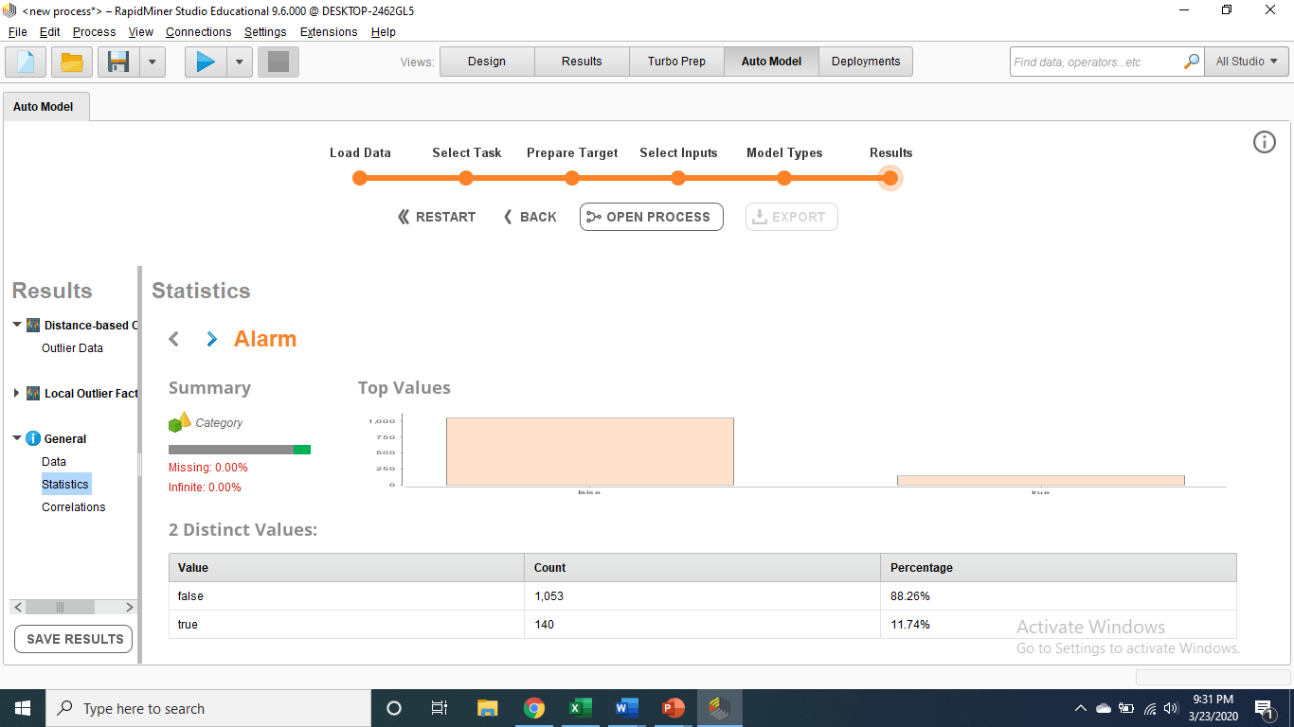
Project analysis slide 5
SHIVANI JAIN
Detailed Analysis of Timestamp

Slide 7
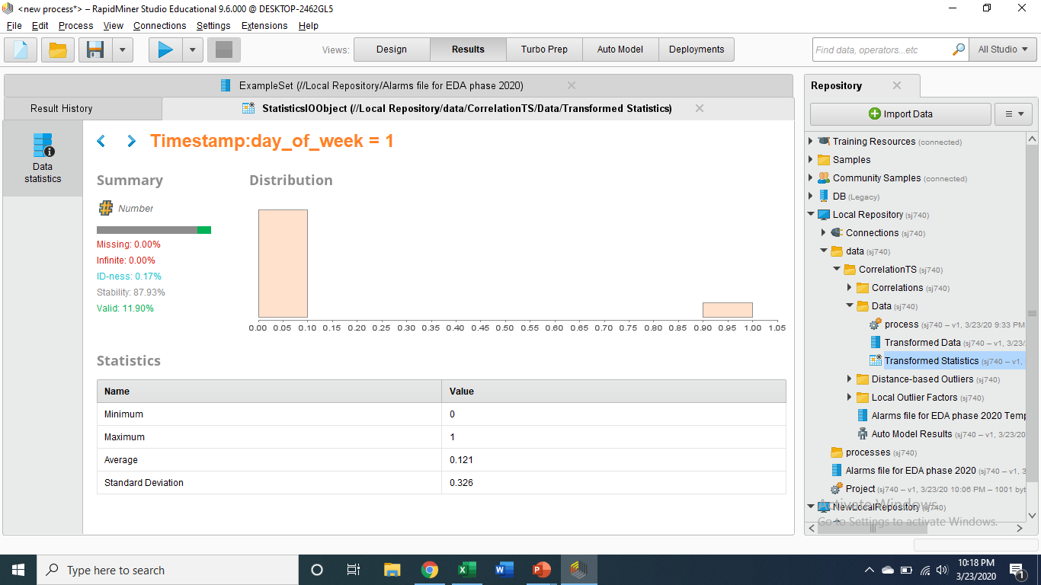

Project analysis slide 5
SHIVANI JAIN
Detailed Analysis of Timestamp

Slide 8


Project analysis slide 5
SHIVANI JAIN
Detailed Analysis of Timestamp

Slide 9
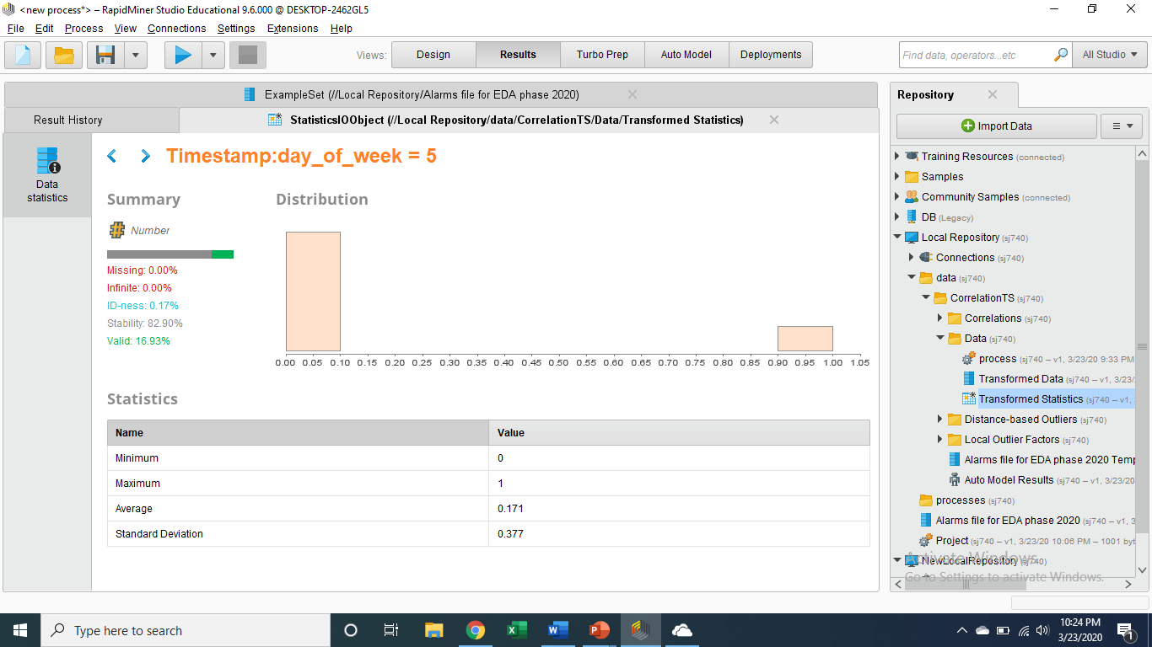

Project analysis slide 5
SHIVANI JAIN
Detailed Analysis of Timestamp

Slide 10
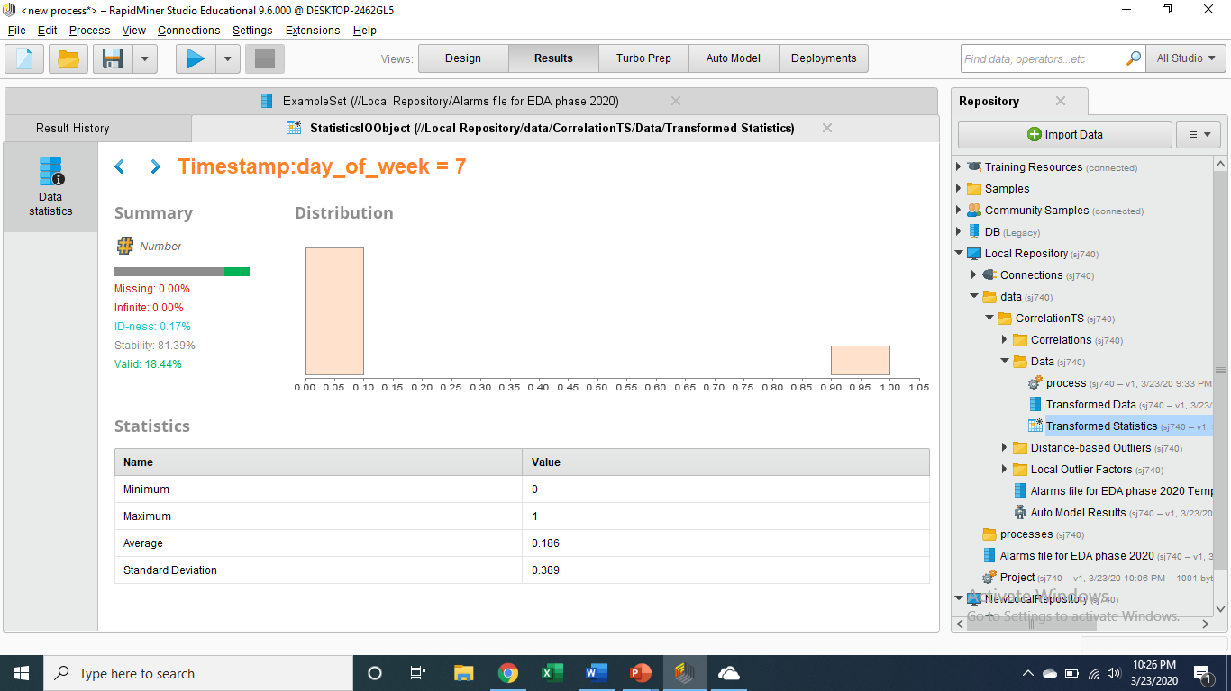
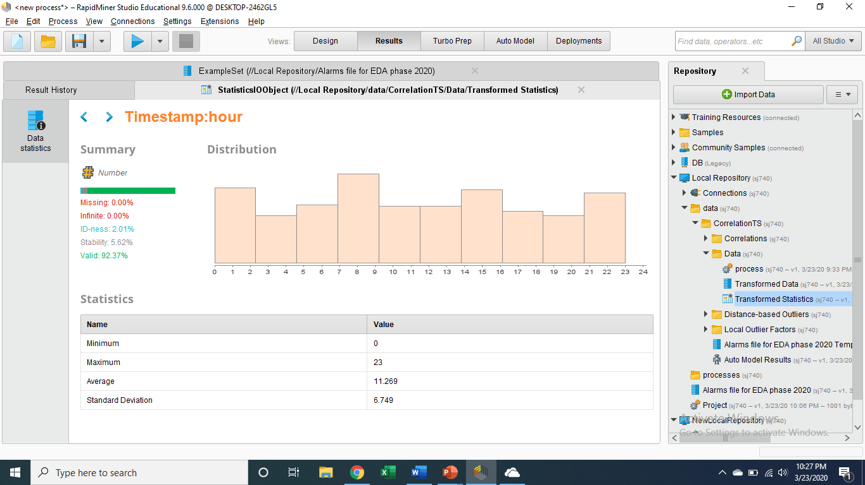
Project analysis slide 5
SHIVANI JAIN
Detailed Analysis of Timestamp

Slide 11
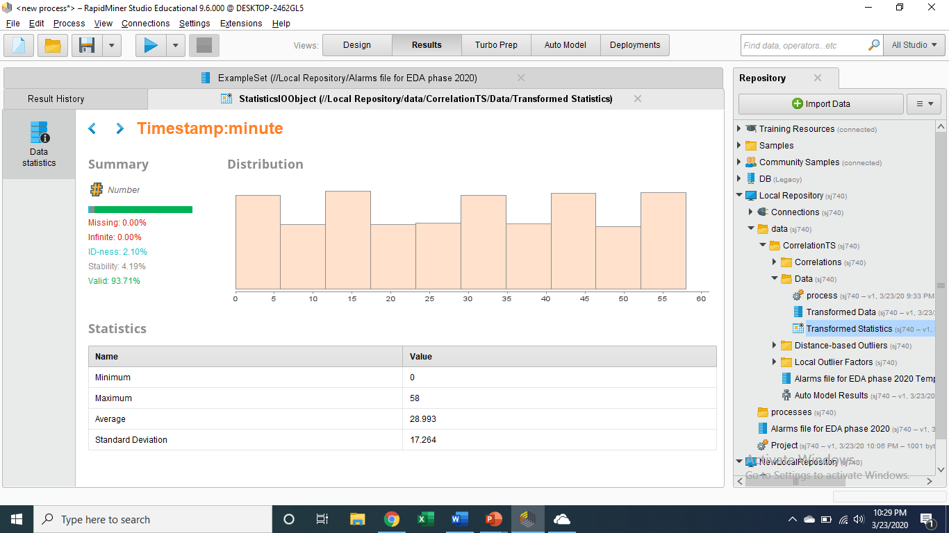
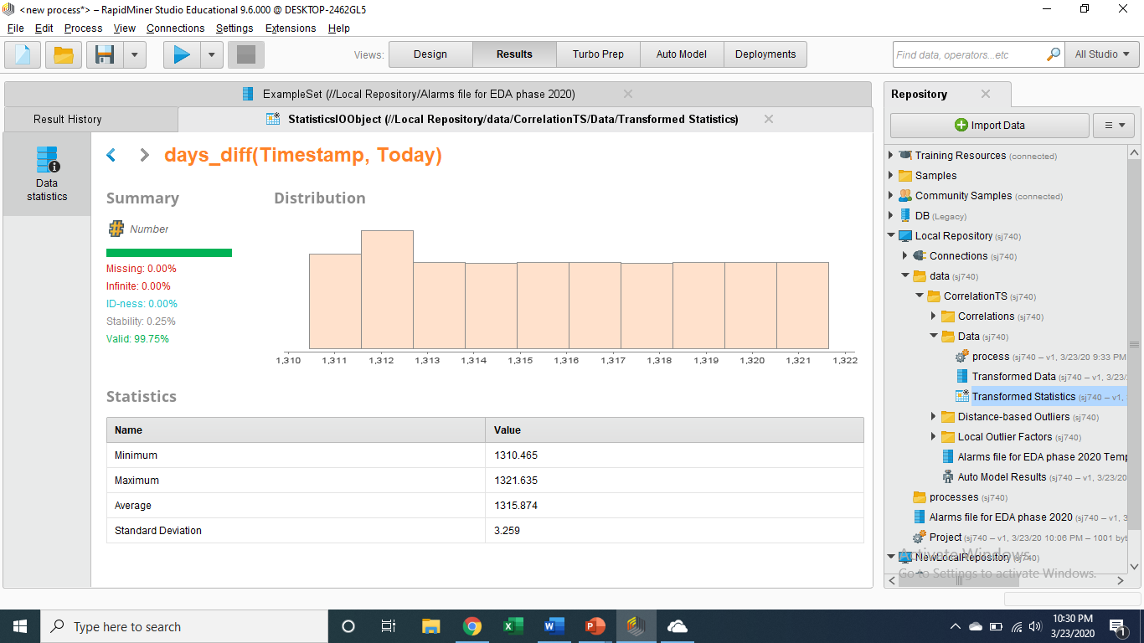
Project analysis slide 5
SHIVANI JAIN
Detailed Analysis of Timestamp

Slide 12
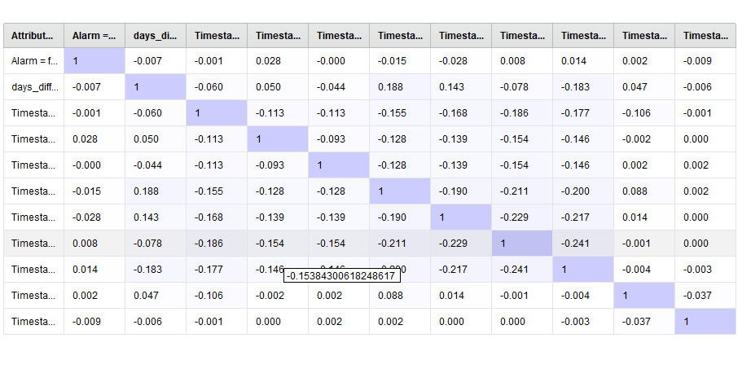
Project analysis slide 5
SHIVANI JAIN
Detailed Analysis of Timestamp

Slide 13
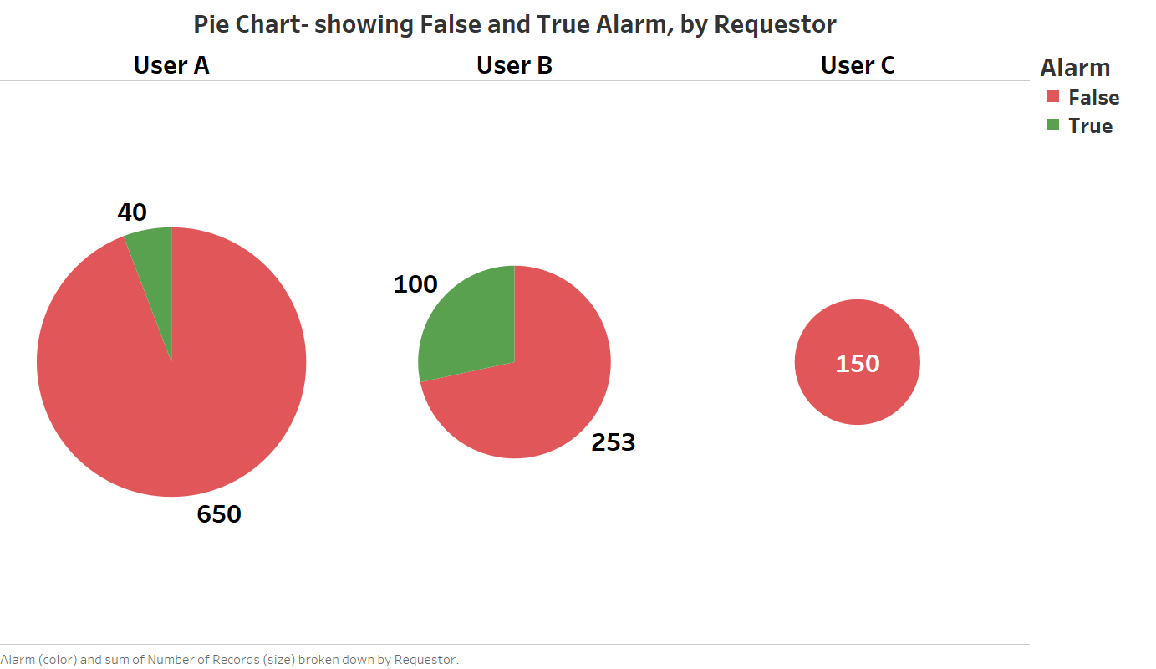
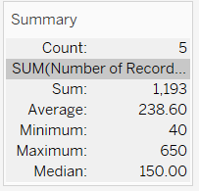
Project analysis slide 5
AISHWARYA KATE
Detailed Analysis of Requestor

Slide 14
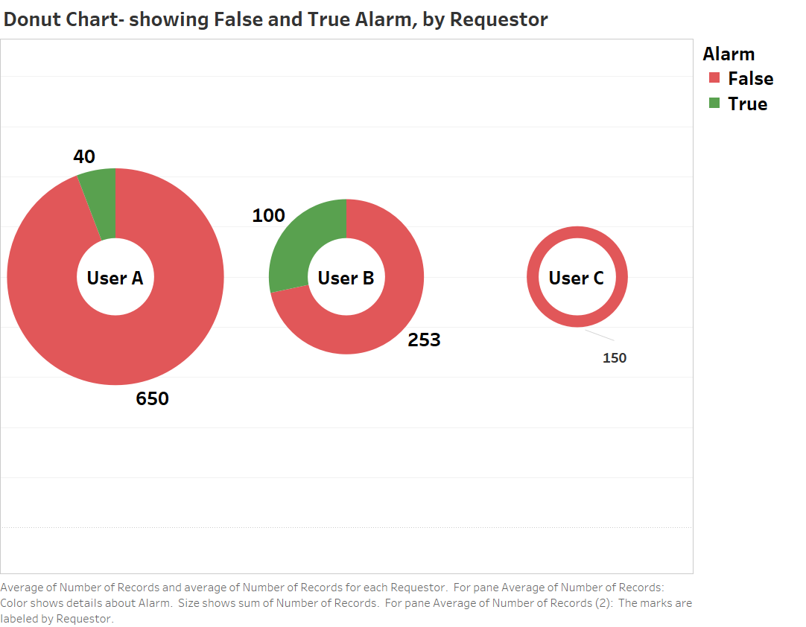
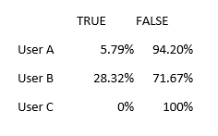
Project analysis slide 5
AISHWARYA KATE
Detailed Analysis of Requestor

Slide 15
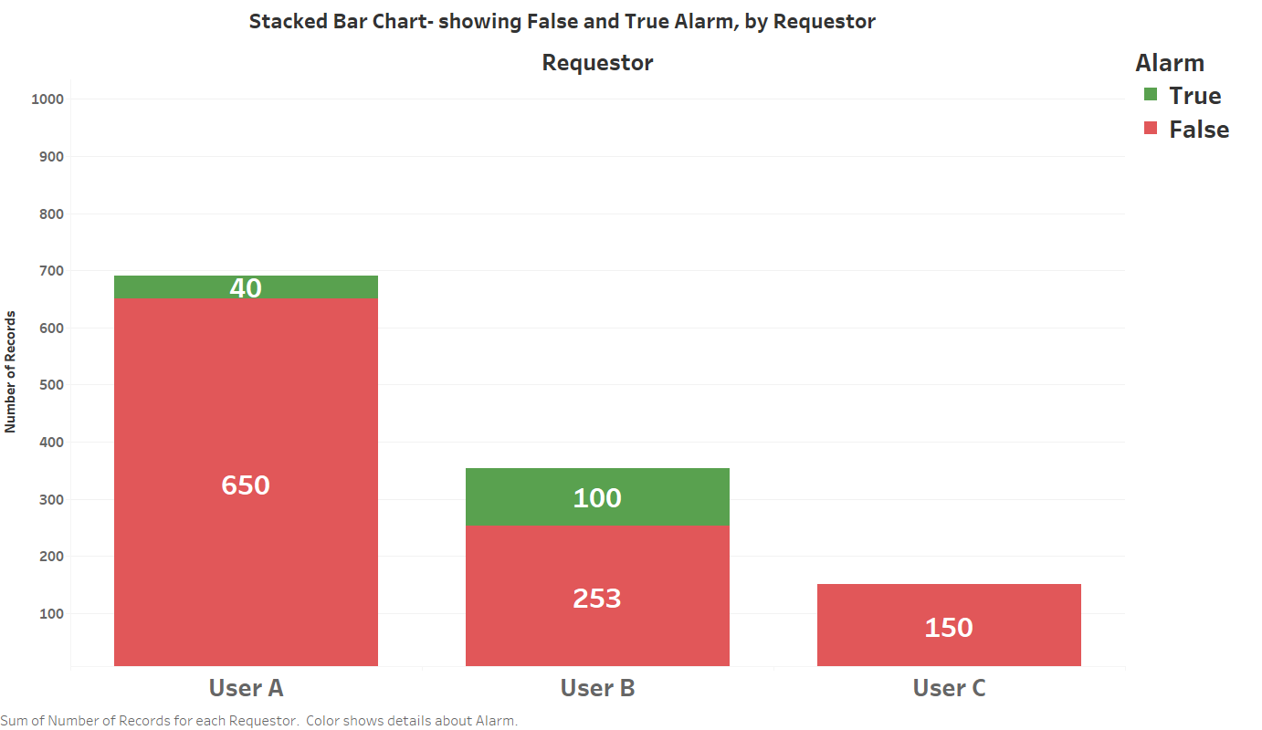
Project analysis slide 5
AISHWARYA KATE
Detailed Analysis of Requestor

Slide 16
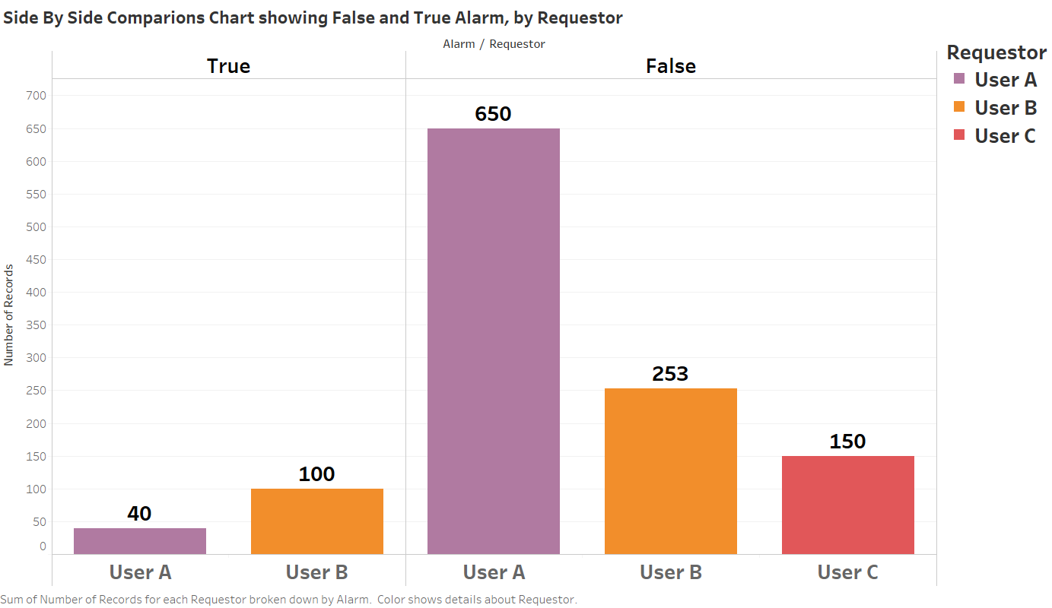
Project analysis slide 5
AISHWARYA KATE
Detailed Analysis of Requestor

Slide 17
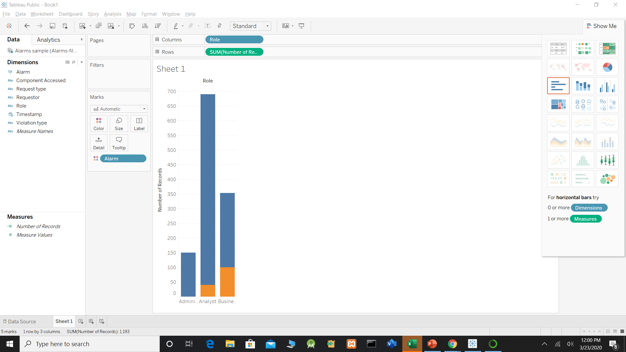
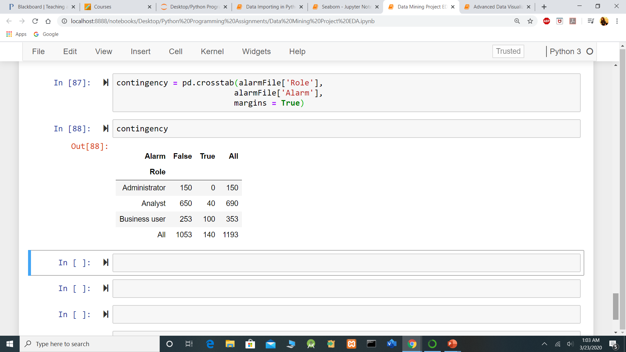
Project analysis slide 5
ADITI JAIN
Detailed Analysis of Role
Contingency Table & Bar Chart
Observations:
All the alarms raised by Administrator Role were False Alarms.
As we can see more than 94% of the alarms were false, which is very high.
Comparatively, almost 72% of the alarms raised by business users were false, which again suggests that there is some issue.

Slide 18
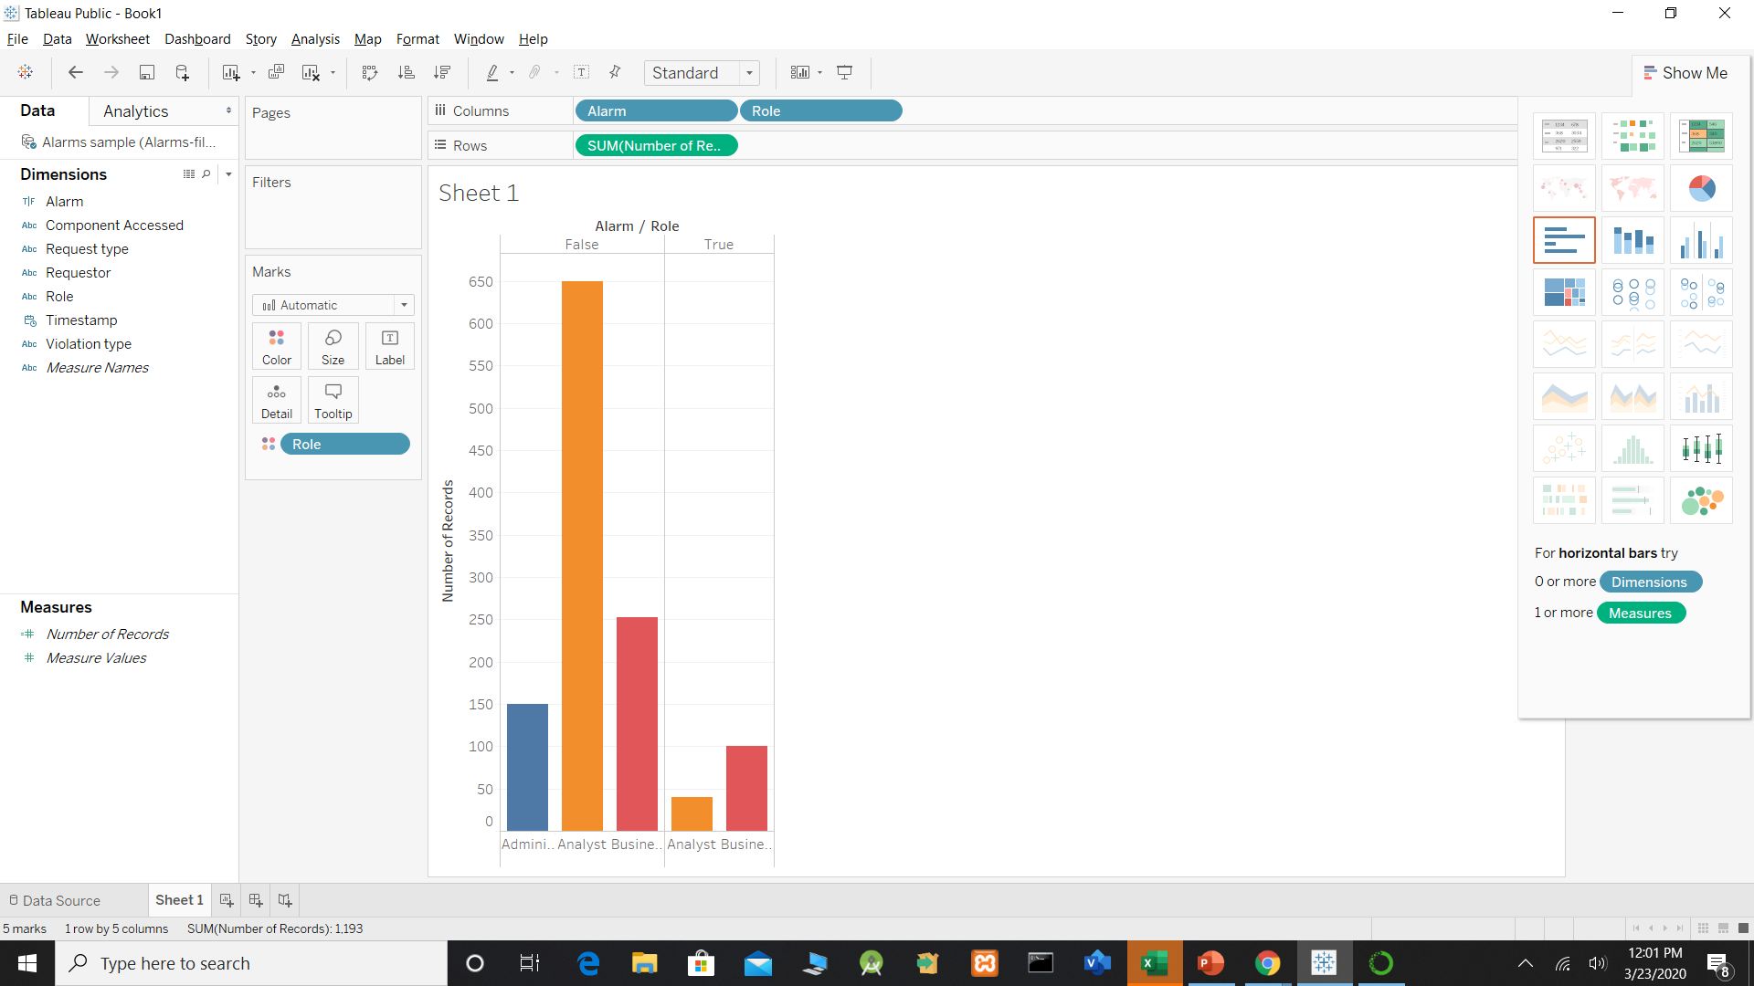
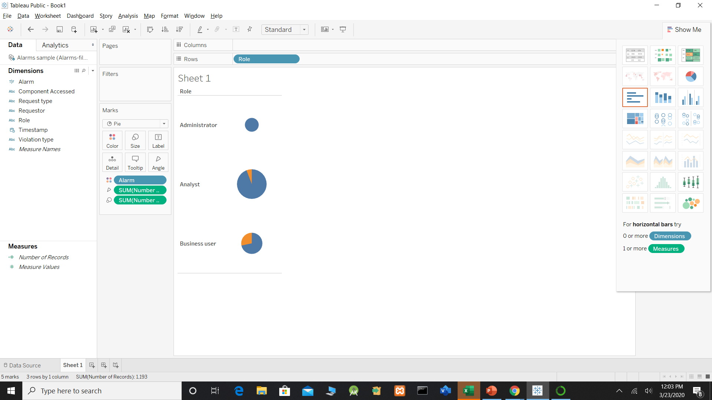
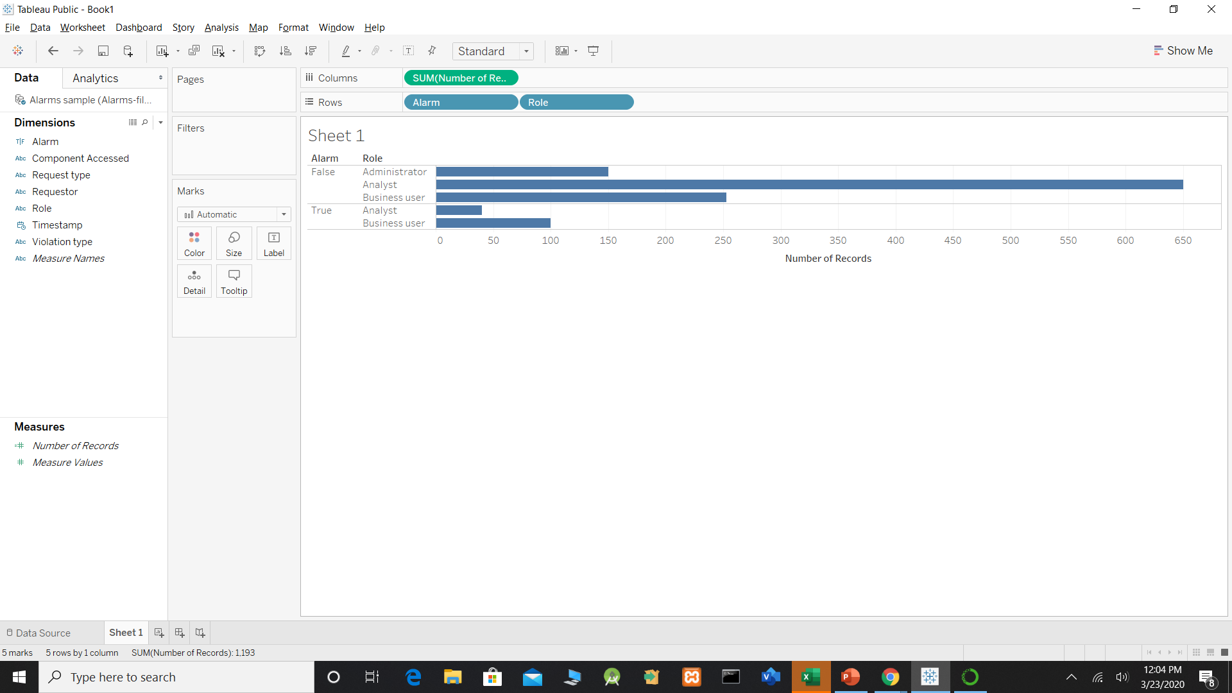
Project analysis slide 5
ADITI JAIN
Detailed Analysis of Role
Summarized EDA Status:
Looking at the Charts, We can suggest following points:
The Alarm inspection team can be more efficient if they focus on inspecting the alerts generated by Business Users first since number of True Alarms by this role is most.
The CISO should look into alarm process & system for Administrator role, as the False alarms are more. I believe there can be system or operational problem.
The Role variable should be included in data mining model.

Slide 19
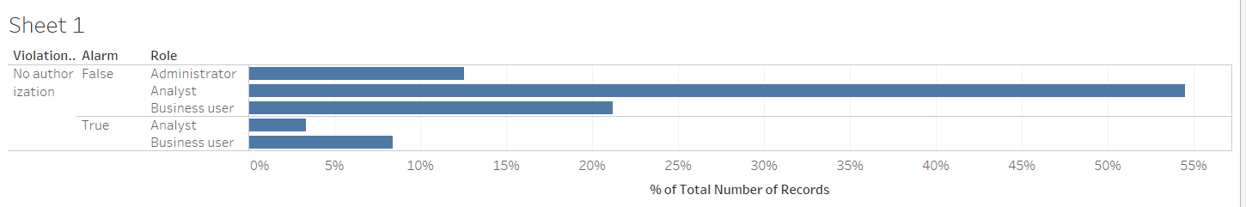
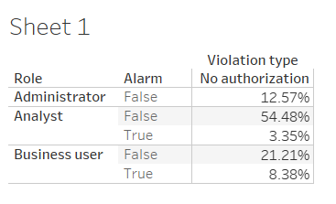
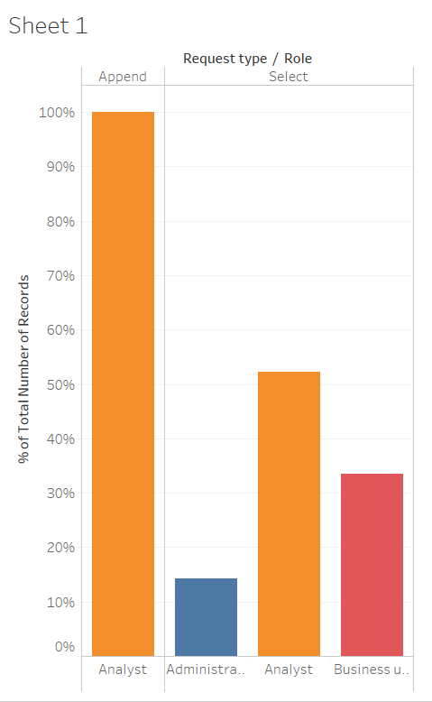
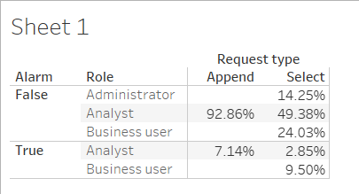
Project analysis slide 5
ADITI JAIN
Detailed Analysis of Role
Correlation between Role & Violation Type
Correlation between Role & Request Type

Slide 20
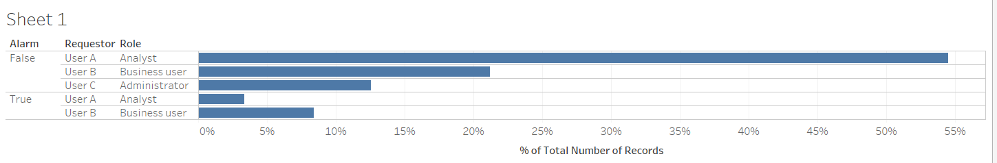
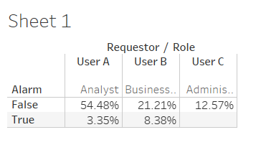
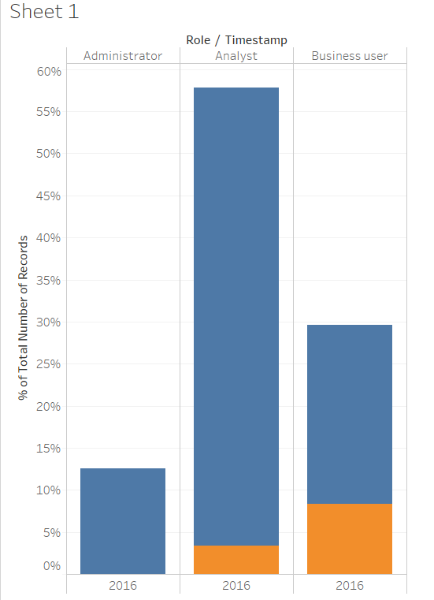
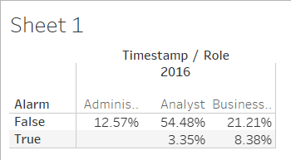
Project analysis slide 5
ADITI JAIN
Detailed Analysis of Role
Correlation between Role & Requestor
Correlation between Role & Timestamp

Slide 21
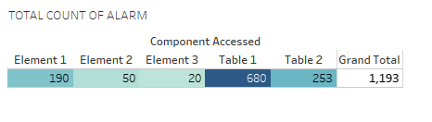
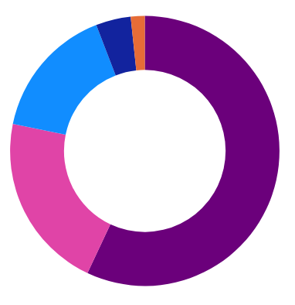
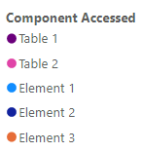
Project analysis slide 5
JASPREET KAUR
Detailed Analysis of Component Accessed
CATEGORICAL VARIABLE (Element 1, Element 2, Element 3, Table 1 and Table 2)
Table 4.1 represents the total proportion of Alarm values when a particular component was accessed. Clearly, the maximum number of alarms (whether True/False) were identified on Table 1 component (680 out of 1193). Table 2, when accessed, generated 253 total alarms out of 1193.
Table 4.1 Contingency Table of Component with total count of alarm
4.19%
1.68%
15.93%
Figure 4.1 shows the total proportion of alarm (in percentages) in each of the component accessed. It appears to indicate that a greater proportion of alarms were identified on Table 1 (57%).
57.00%
21.21%
Figure 4.1 Pie chart showing the total alarms (in percentages) in each component accessed
Notes:
Table 4.1 represents the total proportion of Alarm values when a particular component was accessed. Clearly, the maximum number of alarms (whether True/False) were identified on Table 1 component (680 out of 1193). Table 2, when accessed, generated 253 total alarms out of 1193.

Slide 22
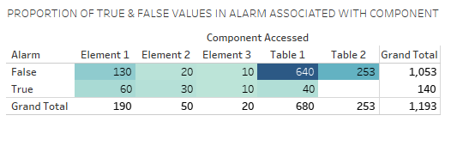
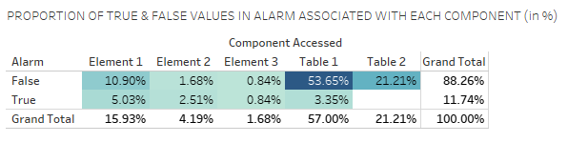
Project analysis slide 5
JASPREET KAUR
Detailed Analysis of Component Accessed
The grand total column in Table 4.2 contains the marginal distribution for alarm.
Similarly, the grand total row represents the marginal distribution for component accessed.
Table 4.2 Contingency Table of Component accessed with Alarm (False/True)
Table 4.3 shows the total percentage of the alarm values in each of the component accessed.
Clearly, the highest number of FALSE POSITIVE alarms were generated in Table 1 (53.65%).
Also, 21.21% of FALSE POSITIVE alarms were generated when Table 2 was accessed. This figure is followed by Element 1 (10.90%), Element 2 (1.68%) and Element 3 (0.84%).
Table 4.3 Contingency Table with percentages of total
Notes:
Table 4.2 is the contingency table that indicates a greater proportion of FALSE POSITIVE alarms in Table 1 – but it is difficult to be sure.
Table 4.3 shows the total percentage of alarm values in each of the component accessed. Clearly, the highest number of false alarms are generated in Table 1 (which is also highlighted in dark blue). Table 2 shows the second highest number of false alarms.

Slide 23
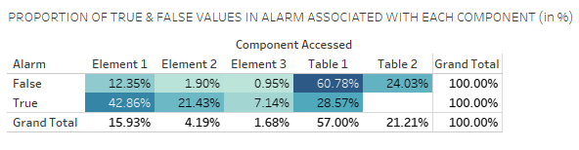
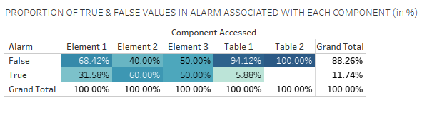
Project analysis slide 5
JASPREET KAUR
Detailed Analysis of Component Accessed
Table 4.4 indicates, for each cell, the percentage of the row total. Clearly, the highest number of FALSE POSITIVE alarms were notified in Table 1 (60.78%) – which could be of major concern.
Also, 24.03% of FALSE POSITIVE alarms were notified when Table 2 was accessed – which again cannot be overlooked. This figure is followed by Element 1 (12.35%), Element 2 (1.90%) and Element 3 (0.95%).
Table 4.4 Contingency Table with row percentages
Table 4.5 compares the proportion of the alarm values (row variable) in each of the component accessed (column variable).
Evidently, 100% of the Table 2 alarm values were FALSE POSITIVES – which could be of major concern.
Also, 94.12% of the Table 1 alarm values were FALSE POSITIVES – which again cannot be overlooked. This figure is followed by Element 1 (68.42%), Element 3 (50%) and Element 2 (40%) alarm values.
Table 4.5 Contingency Table with column percentages
Notes:
Table 4.4 is another contingency table showing the row percentages. Again, Table 1 generates the maximum number of false alarms followed by Table 2.
Table 4.5 is yet another contingency table showing the column percentages. Again, Table 1 generates the maximum number of false alarms followed by Table 1, Element 1, Element 3 and Element 2.

Slide 24
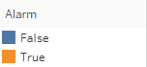
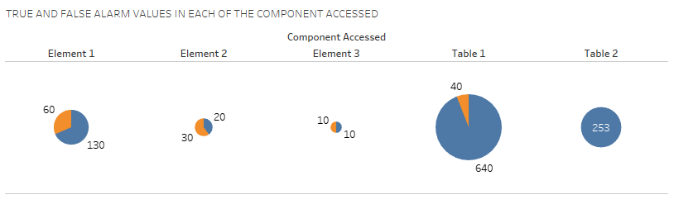
Project analysis slide 5
JASPREET KAUR
Detailed Analysis of Component Accessed
Graphical Counterpart of Contingency Table 4.2
Figure 4.2 Pie chart showing the proportion of FALSE POSITIVE and TRUE POSITIVE alarms in each component accessed
Notes:
Figure 4.2 shows a pie chart of the proportion of false and true alarms generated in each of the component accessed. Looks good.

Slide 25
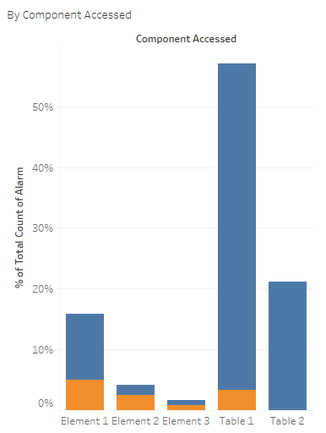

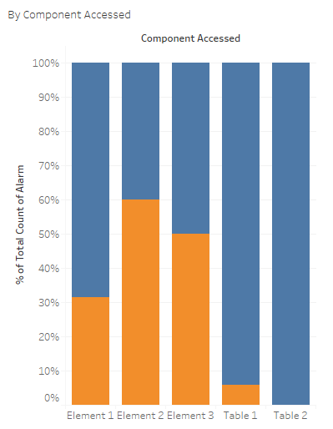
Project analysis slide 5
JASPREET KAUR
Detailed Analysis of Component Accessed
Graphically “normalizing”
Figure 4.3 shows a bar chart of Component accessed, with an overlay of alarms generated as FALSE and TRUE.
The graph clearly appears to indicate that a greater proportion of the FALSE POSITIVE alarms (53.65%) were generated when Table 1 was accessed.
Again, FALSE POSITIVE alarms (21.21%) identified when Table 2 was accessed cannot be overlooked.
This figure is followed by Element 1 (10.90%), Element 2 (1.68%) and Element 3 (0.84%).
40%
68.42%
50%
94.12%
100%
Figure 4.3 Bar chart showing FALSE and TRUE alarm values in
each of the component accessed
Figure 4.4 Stacked Bar Chart to show the same size bars for each of the Component Accessed
Notes:
Figure 4.3 shows a bar chart of the proportion of true and false alarms.
After graphically “normalizing” (to increase the contrast and better discern whether the proportions are different), the same size bars are shown for each of the component accessed. Evidently, Table 2 shows 100% FALSE alarms – which means data is at huge risk (data loss). Again, 94.12% of FALSE POSITIVE alarms on Table 1 cannot be ignored. Confidential information, is again at huge risk – data breach is highly likely. 68.42% of FALSE POSITIVE alarm values on Element 1 is still a big number – which needs to be looked upon. This figure is followed by 50% on Element 3 and 40% on Element 2 – cannot be ignored again.

Slide 26
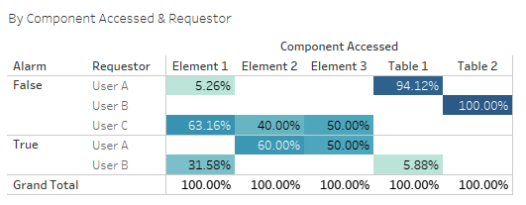
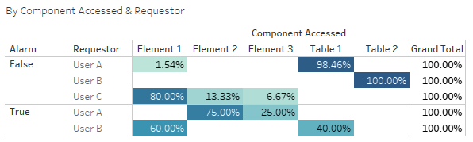
Project analysis slide 5
JASPREET KAUR
Detailed Analysis of Component Accessed
Correlation between Component Accessed & Requestor
Table 4.6 shows the proportion of FALSE and TRUE values in alarm, when a requestor accessed a component.
Clearly, User A (requestor) and Table 1 (component) have high positive correlation (94.12%).
Similarly, User B (requestor) and Table 2 (component) have high positive correlation (100%).
Also, User C (requestor) and Element 1 (component) are moderately correlated (63.16%).
Table 4.6 Contingency table of Component & Requestor with column percentages
Clearly, User A (requestor) and Table 1 (component) have high positive correlation (98.46%).
Similarly, User B (requestor) and Table 2 (component) have high positive correlation (100%).
Also, User C (requestor) and Element 1 (component) are moderately correlated (80%).
Table 4.7 Contingency table of Component & Requestor with row percentages
Notes:
Table 4.6 is a contingency table showing column percentages and Table 4.7 shows row percentages of the true and false alarms generated by different users when they accessed a particular component. Now, when you take individual values of the variables, you can easily tell the correlation between them. Clearly, User A and Table 1 have high correlation. User B and Table 2 have high correlation again. User C and Element 1 are moderately correlated.

Slide 27
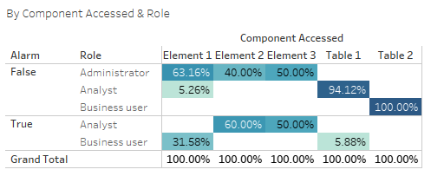
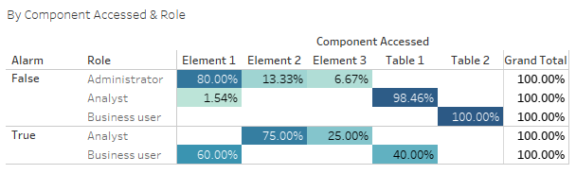
Project analysis slide 5
JASPREET KAUR
Detailed Analysis of Component Accessed
Correlation between Component Accessed & Role
Table 4.8 shows the proportion of FALSE and TRUE values in alarm, when any user with roles Administrator, Analyst, Business User accessed a component.
Clearly, Analyst (role) and Table 1 (component) have high positive correlation (94.12%).
Similarly, Business User (role) and Table 2 (component) have high positive correlation (100%).
Also, Administrator (role) and Element 1 (component) are moderately correlated (63.16%).
Table 4.8 Contingency table of Component & Role with column percentages
Clearly, Analyst (role) and Table 1 (component) have high positive correlation.
Similarly, Business User (role) and Table 2 (component) have high positive correlation.
Also, Administrator (role) and Element 1 (component) are moderately correlated.
Also, it is evident that ‘Role’ and ‘Requestor’ are strongly correlated to each other because the results overlap.
Table 4.9 Contingency table of Component & Role with row percentages
Notes:
Table 4.8 is a contingency table showing column percentages and Table 4.9 shows row percentages of the true and false alarms generated by different roles when they accessed a particular component. Now, when you take individual values of the variables, you can easily tell the correlation between them. Clearly, Analyst and Table 1 have high correlation. Business User and Table 2 have high correlation again. Administrator and Element 1 are moderately correlated. I found out that ‘Role’ and ‘Requestor’ are the same. User A is the Analyst, User B is the Business User and User C is the Administrator.

Slide 28
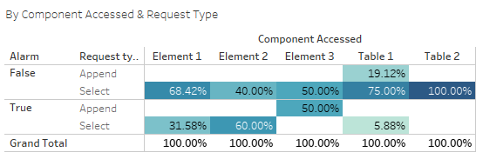
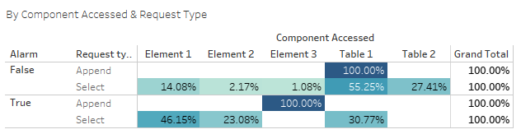
Project analysis slide 5
JASPREET KAUR
Detailed Analysis of Component Accessed
Correlation between Component Accessed & Request Type
Table 4.10 shows the proportion of FALSE and TRUE values in alarm, when a request (Select/Append) is made on a component.
Clearly, Append (Request Type) and Table 1 (Component) are loosely correlated (19.12%).
Similarly, Select (Request Type) and Table 2 (Component) have high positive correlation (100%).
Table 4.10 Contingency table of Component & Request Type with column percentages
Clearly, Append (Request Type) and Table 1 (Component) have high correlation (100%).
Similarly, Select (Request Type) and Table 1 (Component) have high positive correlation (55.25%).
Table 4.11 Contingency table of Component & Request Type with row percentages
Notes:
Table 4.10 is a contingency table showing column percentages and Table 4.11 shows row percentages of the true and false alarms generated when a user made a query on a particular component. Clearly, Select on Table 2 generates 100% false alarms – so we might need to check them and do something to reduce this number. Also, Select on Element 2 generates 60% true alarms – which is a concern. Clearly, looking at these overwhelming figures, Table 1, Table 2 and Element 1 generate a great proportion of false alarms – which need to be checked.

Slide 29
Project analysis slide 5
Detailed Analysis of Component Accessed
JASPREET KAUR
Summary of EDA on Component Accessed
Table 1 was accessed by the Analyst role the maximum number of times - CISO should investigate if there was any data leak or data breach
Table 2 was only accessed by Business User, which caused all the FALSE alarms (253) - CISO should be concerned about the motive of the Business User behind accessing Table 2
Element 1 was mostly accessed by the Administrator, which caused 80% false alarms out of the total false alarms generated by Administrator - CISO should check if it is really the Administrator who accessed Element 1 or somebody else in the organization has access to Administrator details
Element 1 was also accessed by Business User, which caused 60% true alarms out of the total true alarms generated by Business User - CISO should push these true alarms and send the report to the Security analysts immediately and also check if there was loss of any other confidential information
Element 2 & Element 3 were accessed by Analyst, which caused 75% and 25% true alarms - which is of major concern. CISO should investigate this number and check if any confidential information has been lost
Table 1 was also accessed by Business User, which caused 40% true alarms out of the total true alarms generated by Business User - CISO should push these alarms to the Security Analysts and investigate if the Business is causing any trouble in terms of data breach

Slide 30
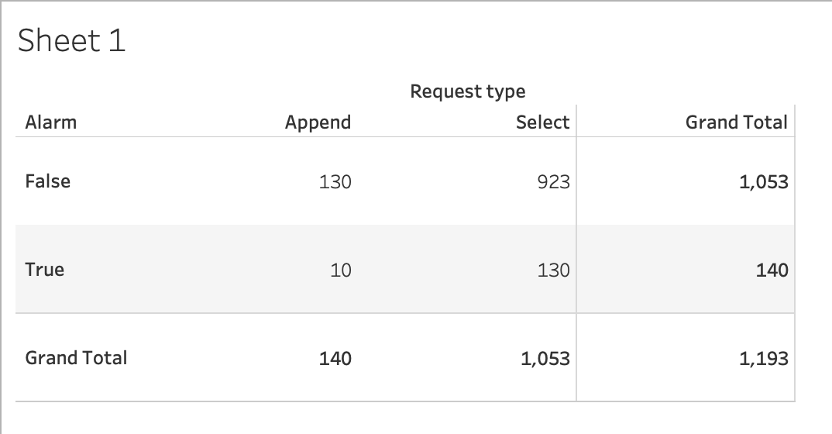
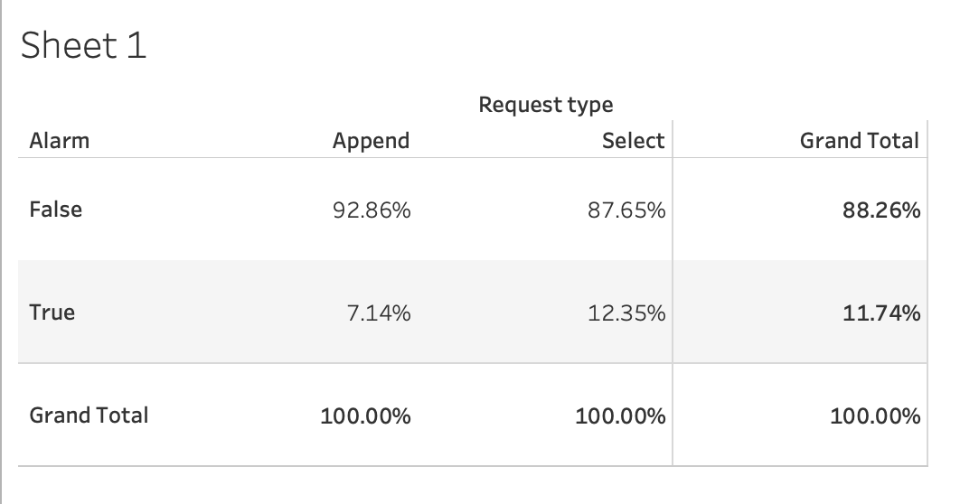
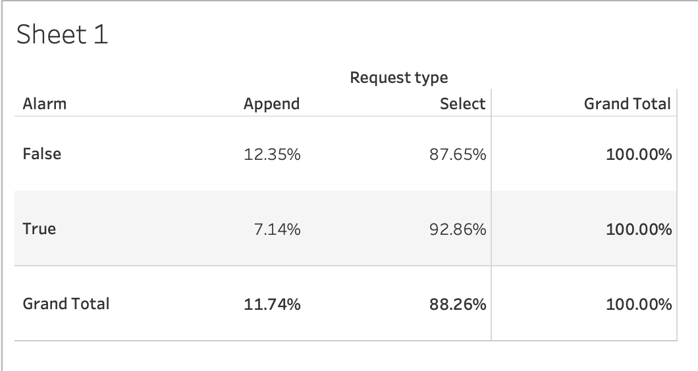
Project analysis slide 5
AKSHAY JADHAV
Detailed Analysis of Request Type
In above, append creates more false alarms than select command. (Percentile column wise)
From above,
False Alarm Rate (Append) – 92.86%
False Alarm Rate (Select) – 87.65%
In above, select creates more false alarms than append command. (Percentile row wise)

Slide 31
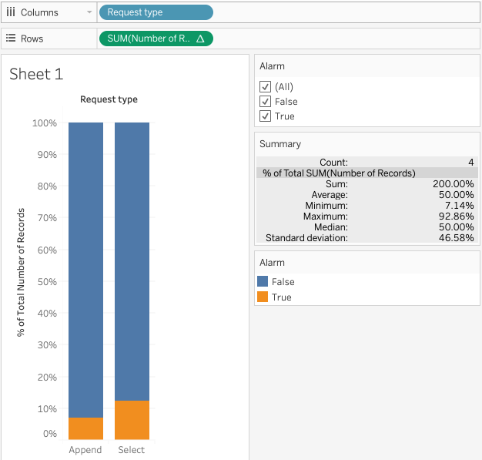
Project analysis slide 5
AKSHAY JADHAV
Detailed Analysis of Request Type
Graphically “Normalizing”

Slide 32




Project analysis slide 5
AKSHAY JADHAV
Detailed Analysis of Request Type

Slide 33


Project analysis slide 5
Detailed Analysis of Request Type
AKSHAY JADHAV
Request Type & Component Accessed (Correlation)
In the above, there are 3 analysis (column wise) :
Append on Table 1 creates FALSE alarms – 100% (False Alarm Rate – Append on Table 1)
Select on Table 2 creates FALSE alarms – 100% (False Alarm Rate – Select on Table 2)
Select on Table 1 creates most of the FALSE alarms – 92.73% (False Alarm Rate – Select on Table 1)

Slide 34

Detailed Analysis of Request Type
AKSHAY JADHAV
Request Type & Component Accessed (Correlation) – Row Wise
In the above, there are 3 analysis (row wise) :
Append on Table 1 creates FALSE alarms – 12.35% (False Alarm Rate – Append on Table 1)
Select on Table 2 creates FALSE alarms – 24.02% (False Alarm Rate – Select on Table 2)
Select on Table 1 creates most of the FALSE alarms – 48.43% (False Alarm Rate – Select on Table 1)

Slide 35



Project analysis slide 5
AKSHAY JADHAV
Detailed Analysis of Request Type
Request Type & Component Accessed (Correlation)

Slide 36
Detailed Analysis of Request Type
AKSHAY JADHAV
Summary of EDA on Request Type
Select query on Table 1 creates most of the false alarms
CISO should investigate why select query is running on Table 1 frequently in a database? Is there any misuse of grants given on the Table 1?
Select query on Element 1 creates most of the True alarms
CISO should push these True alarms to security analysts, to verify if these alarms causing any unpredictable effects on business.
Append on Table 1 create only false alarms
CISO should investigate who all are accessing the the Table 1 for append operation? And why it’s creating only false alarms? Whether it impacts our whole system?
Append on Element 1 create only True alarms
CISO should verify that is they really are true alarms, because if they are actual true positive alarms, then it would impact overall performance of the system if misguided.

Slide 37

Project analysis slide 5
RASHMI JAIN
Detailed Analysis of Violation Type
Exploratory Data Analysis
Violation Type: It contains one element that is No Authorization.
Violation type is compared with Result variable “Alarm”.
Side by Side Bar Chart:
Looking at the charts, we
have the following points to suggest:
88.26 % of the data are False and 11.74% are True for violation type compared to Alarm.

Slide 38


Project analysis slide 5
RASHMI JAIN
Detailed Analysis of Violation Type
Observation:
Alarm displaying compared to violation
type is 88.26% for False.
For Violation type true alarm is 11.74%
Conclusion:
Violation type will not affect the
target variable “Alarm”.
Normalized Histogram

Slide 39
Project analysis slide 8
JASPREET KAUR
Group Summary and Conclusions
Binary Classification problem dealing categorical data (Timestamp, Requestor, Role, Component, Request Type & Violation Type)
Timestamp has very low correlation with the target variable and other variables too (Correlation: 0.00%). Removing it may speed up the model building
‘Requestor’ & ‘Role’ variables are same since a user can have only one role. In other words, both variables are perfectly correlated. Hence, one of them can be omitted from data set
Component Accessed has strong correlation with the target variable (0.58%)
For Violation Type, EDA uncovers no obvious association of alarm values. Good to remove from data set since the column is practically constant, with all values being the same
Request Type has weak correlation with the target variable (0.27%)
Insights with respect to Alarm:
There were a total of 1193 alarms, 140 of which (11.74%) were true alarms and 1053 (88.26%) were FALSE alarms
Table 1 was most accessed by User A (Analyst Role), which caused the maximum number of FALSE alarms (640)
User A, which is in the role of Analyst, generated the most number of FALSE alarms (650)
Table 2 was only accessed by User B (Business User Role), which generated only FALSE alarms
User B, the Business User role, generated 253 FALSE alarms and 100 TRUE alarms (TRUE alarms are the highest among all)
User C (the Administrator Role) attempted to access Element 1, Element 2 & Element 3 and generated only FALSE alarms
User C, the Administrator Role, generated only FALSE alarms (150) on accessing the database
Notes:
While this might seem as a time series problem at first glance, timestamp variable isn’t relevant to the problem. This is because when we single out one unique value per variable, we find that that target variable also returns single value throughout the data values. Role, Component and Request Type are the most important predictor variables.
Role and Requestor are perfectly correlated. Hence, we would not retain both the variables in the model, but rather omit one. We would take ‘Role’.
Violation Type: Not really useful as a part of EDA. May or may not be a part of ML model. Since, the column is practically constant, with all the values being the same. Good to remove from the data set. But this variable can still be retained as input to downstream data mining models.
Timestamp: May or may not be a part of the data set. Good to remove.
Total of 1193 alarms : 140 true and 1053 false.
User A (Analyst) generated the maximum false alarms.
User B (Business User) generated both false and true alarms (true alarms are highest)
User C (Administrator) generated only FALSE alarms.
Table 1 was most accessed by User A (Analyst) – generated the maximum False alarms
Table 2 was only accessed by User B (Business User) – generated only False alarms

Slide 40




Project analysis slide 10
JASPREET KAUR
Group Summary & Conclusions
Recommended Machine Learning Models:
Logistic Regression
Decision Tree
Naïve Bayes Classification
A Go-to method for binary classification problems (Supervised Classification algorithm
A type of supervised learning algorithm, mostly used in classification problems
A type of supervised learning algorithm, which comes under the Bayesian Classification
Trees answer sequential questions and the model behaves as “if this, then that”, yielding a specific result
Predictive Analysis Algorithm based on the concept of probability
Uses probability for doing predictive analysis
Used to assign observations to a discrete set of classes (here, TRUE and FALSE)
A type of supervised learning algorithm, mostly used in classification problems
Low-variance classifier and is a good model for even small data sets
Gives best performance in terms of total time to build the model (5 seconds)
Works on the assumption that the predictor variables are independent – not so naive
Easy to interpret and make for straightforward visualizations
Gives 100.00% accuracy results
Gives 96.5% accuracy in the start
Extremely fast to build and learn and provides an accuracy of 96.8% in the start
Very efficient and easy-to-use; highly interpretable
Powerful Machine Learning Technique; simple to use and computationally inexpensive
Notes:
Logistic Regression is the appropriate regression analysis to conduct when the dependent variable is dichotomous (binary). Unlike linear regression which outputs continuous number values, logistic regression transforms its output using the logistic sigmoid function to return a probability value which can then be mapped to two or more discrete classes. Gives us a discrete binary outcome between 0 and 1. Used to describe data and to explain the relationship between one dependent binary variable and one or more nominal, ordinal, interval or ratio-level independent variables.
Decision Tree: In this technique, we split the population or sample into two or more homogeneous sets (or sub-populations) based on most significant splitter / differentiator in input variables.
Naïve Bayes: The naïve in the name tells us that it’s an irrational assumption and it won’t affect the accuracy. After all, it’s not so naïve.

Slide 41
Thank You

